Slide 1
Via-Stripline Modeling
Yifan Ding, Hyunwook Park, and Chulsoon Hwang
10/16/2024

Slide 2
Outline
Last meeting:
Implement the partial inductance and the tx-line inductance in more cases (with larger antipad)
Tune L and R for different stackups
Check the G effect → check E and H field
This week:
Equivalent circuit with extra C between stripline in antipad region and the reference plane
Validation for partial inductance using a simple case

Slide 3
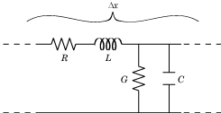
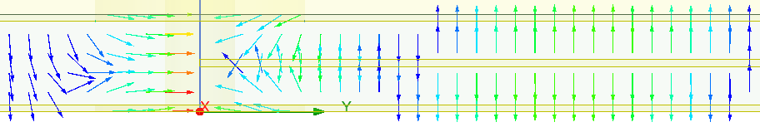
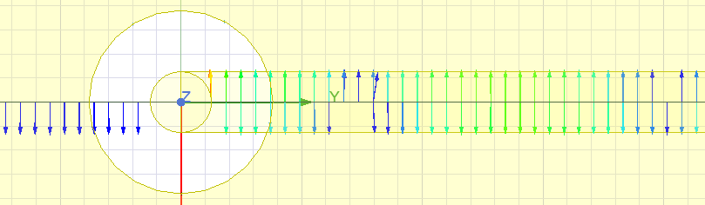
Last meeting: What should be included?
E-field @ 60GHz
CG in the antipad region is different from the tx-line CG
Side view
H-field @ 60GHz
Top view
RL in the antipad region is similar as the tx-line RL

Slide 4
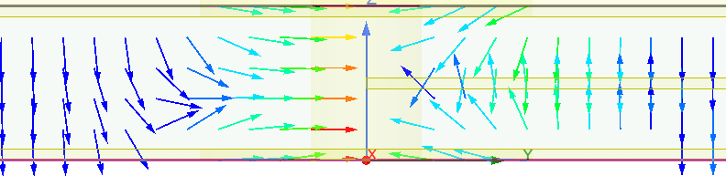
Last meeting: Plate-stripline Capacitance in the Antipad Region
E-field @ 60GHz
C_via
C_str
C_str
C_via

Slide 5
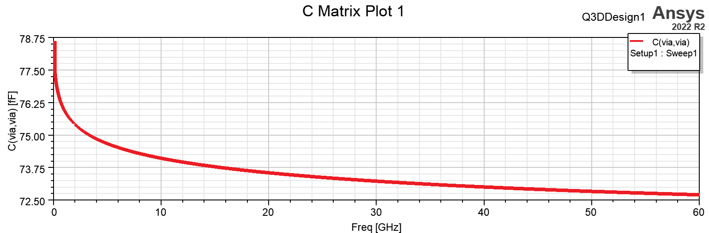
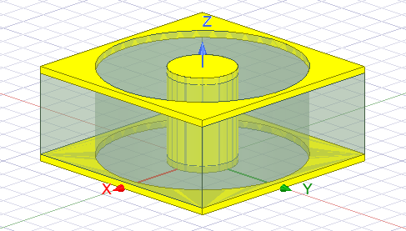
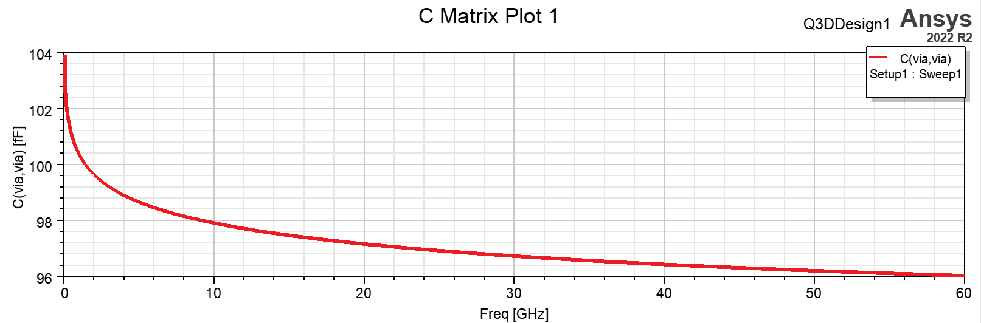
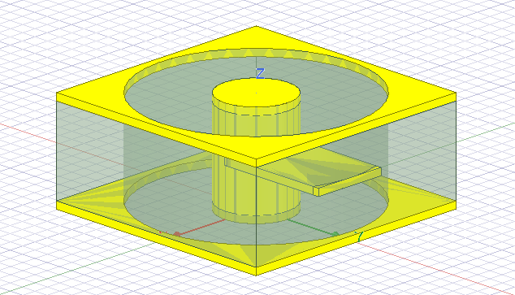
Last meeting: Q3D Capacitance Simulation
From the calculation in via model: C_top + C_bottom = 62.67 fF
Only via
ΔC @ 60GHz = 23.33 fF
Via + stripline

Slide 6
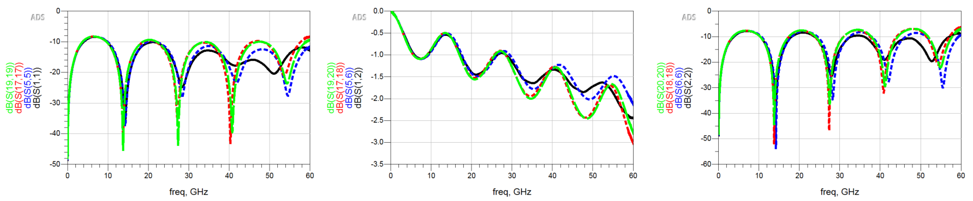
Add the additional capacitance to the via-stripline model
HFSS
With tx-line RL
With tx-line RL + additional C (1)
With tx-line RL + additional C (2)
C_via
C_via
C_str
C_str
C_str
C_str
C_via
C_via
(1) Previous structure
(2) New structure

Slide 7
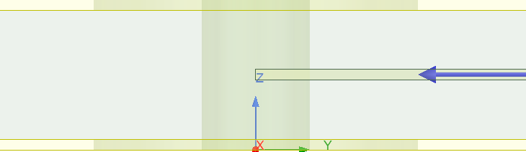

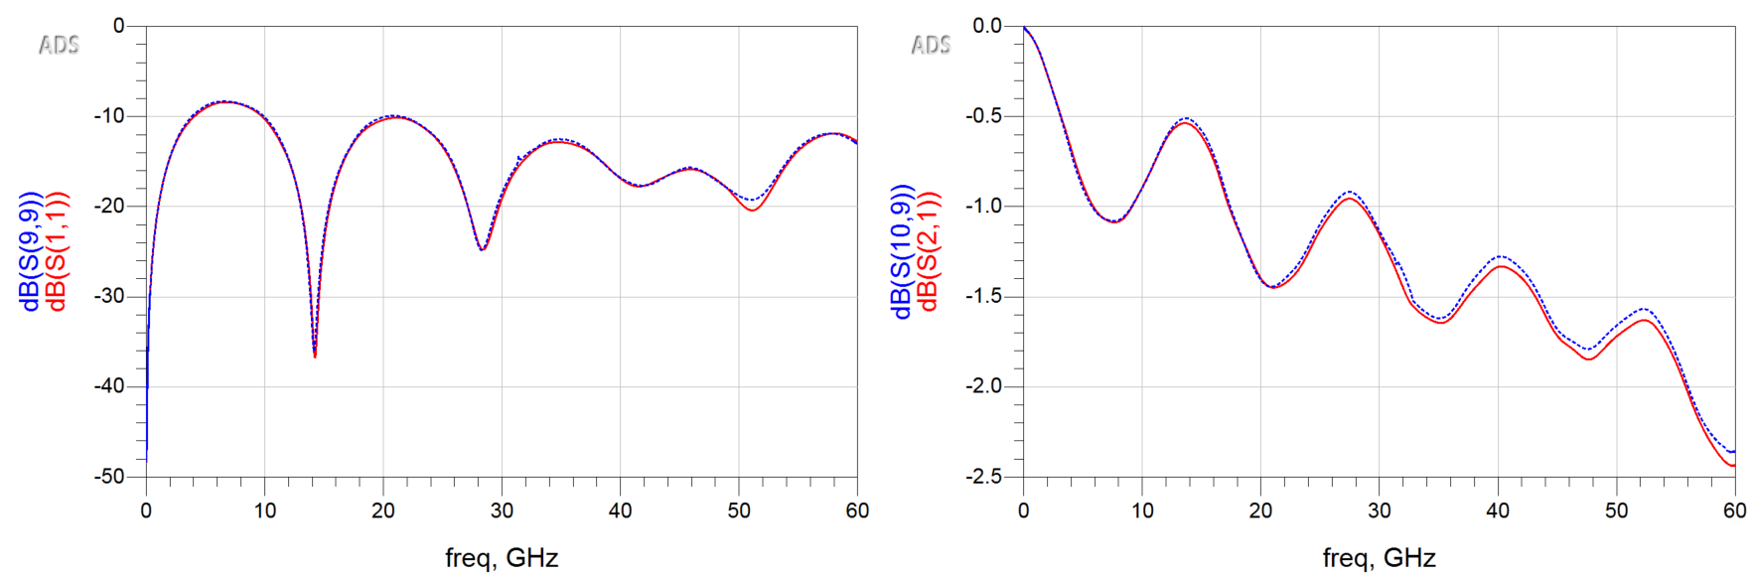
Check structure cascading
P1
P1
P2
P2
P1
P2
Simulate with the whole structure
Cascade the two parts
S11
S21

Slide 8
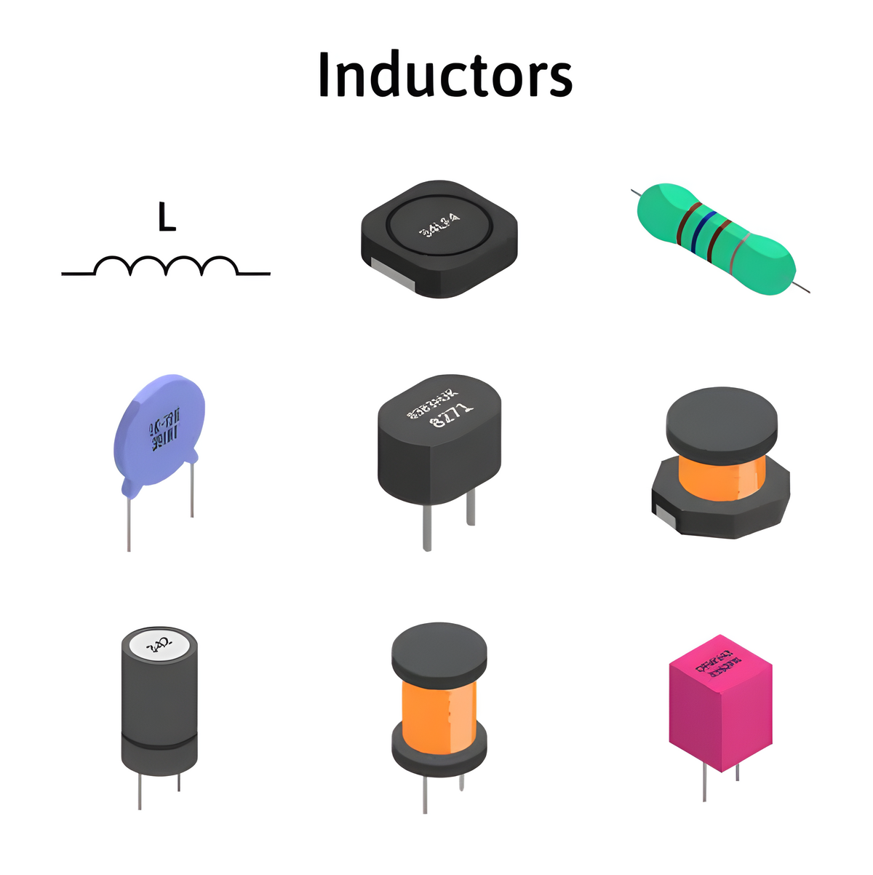
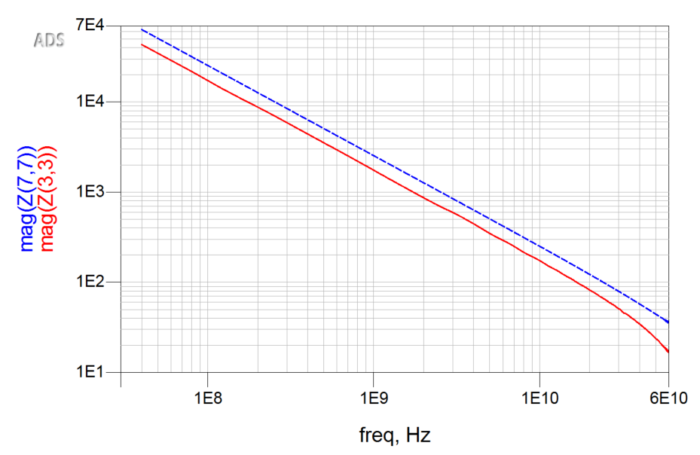
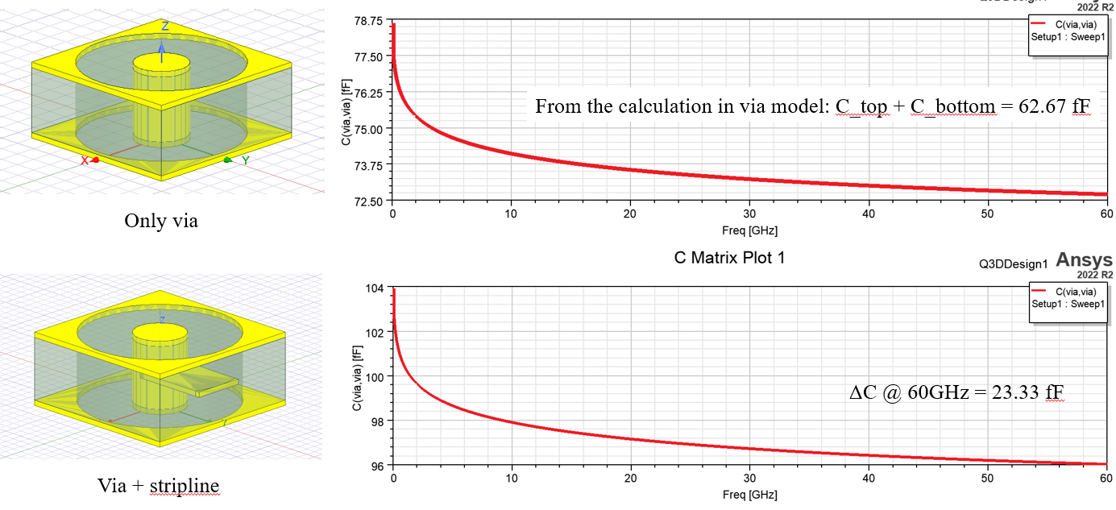


Via + stripline in antipad region
Port 1
P1
?
C_{top}
P2
$$Y^{′}$$
$$Y_{0}$$
Port 2
C_{bot}
Simulation C = 90.88 fF
Equivalent circuit C = 62.69 fF
ΔC = 28.20 fF
Plate-stripline (or via-stripline) capacitance in the antipad region should be included in the model.
S-parameter cannot match well after adding the capacitance. Need to simulate to higher frequency to check the inductance.

Slide 9
Validation Case
Microstrip
P1
Via
P2
GND
?
Microstrip
Microstrip
P1
P2
Via
P1
P2
GND
GND
s2p
Partial L
s2p

Slide 10
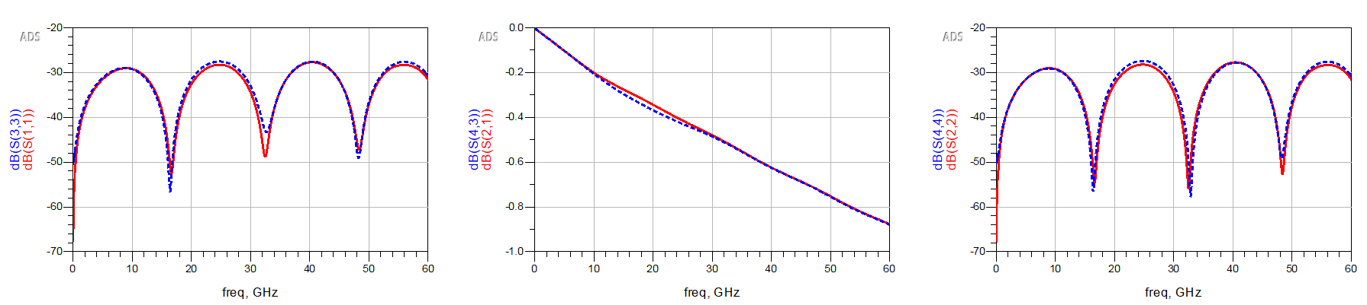
Microstrip
Microstrip
Microstrip
P1
P2
P1
P2
P1
P2
GND
GND
GND
s2p
s2p
s2p
S11
S21
S22

Slide 11
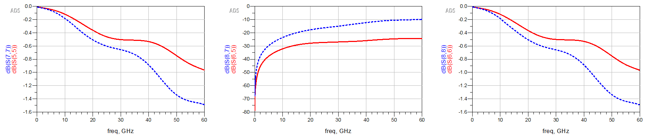
Microstrip
Microstrip
Microstrip
P1
P2
Via
P1
P2
P1
P2
GND
GND
GND
s2p
Partial L = 25.64 pH
s2p
s2p
S11
S21
S22

Slide 12
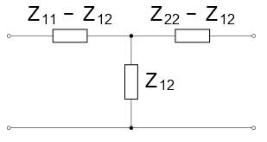
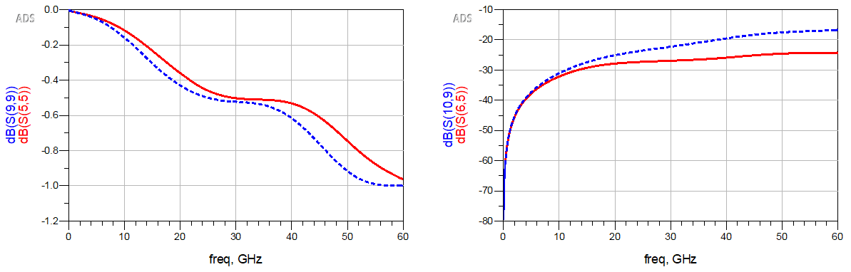
Equivalent T type circuit
Microstrip
Microstrip
P1
Via
P2
Via
L extracted from Z12 = 10.79 pH

Slide 13
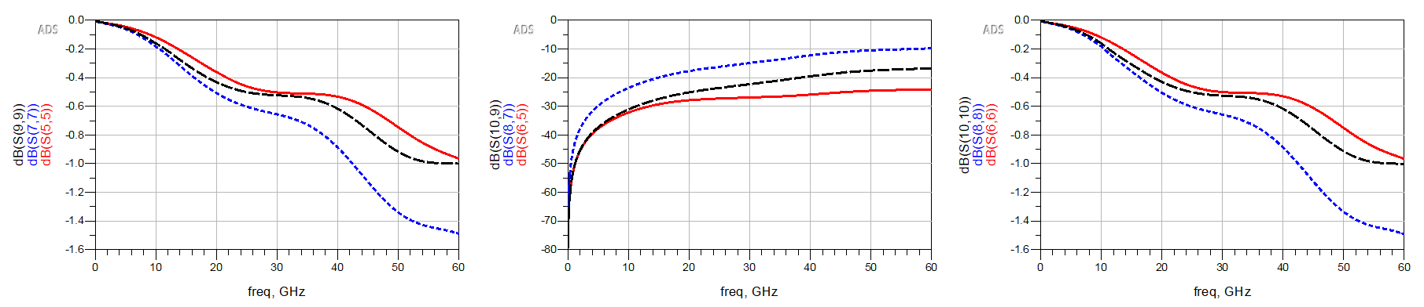
Comparison
Simulation
With partial L
With L from T type circuit
S11
S21
S22

Slide 14
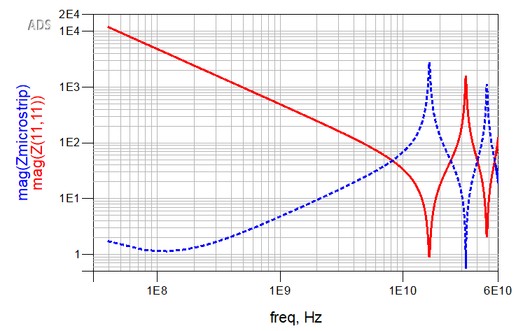
Problem
P1
Via
P2

